Slide 1










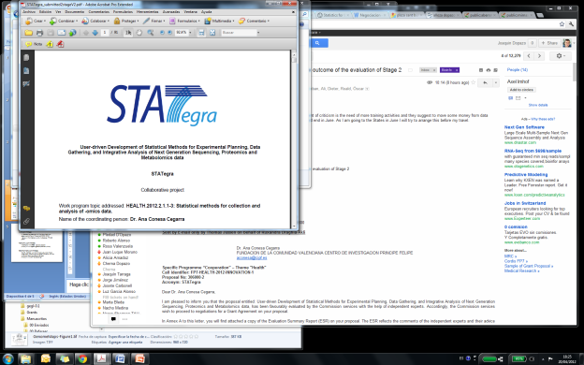


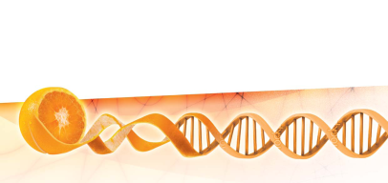


A NGS data analysis course Introduction
Joaquín Dopazo
Computational Genomics Department,
Centro de Investigación Príncipe Felipe (CIPF),
Functional Genomics Node, (INB),
Bioinformatics Group (CIBERER) and
Medical Genome Project,
Spain.
http://bioinfo.cipf.es
http://www.medicalgenomeproject.com
http://www.babelomics.org
http://www.hpc4g.org
@xdopazo
University of Cambridge, 23-25 February 2015

Slide 2
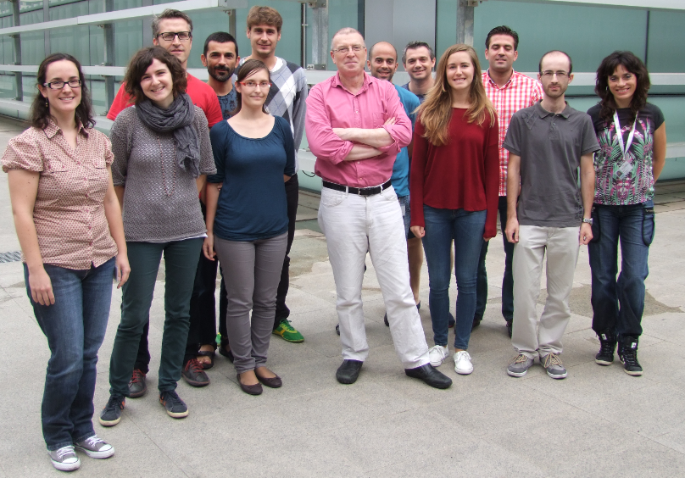
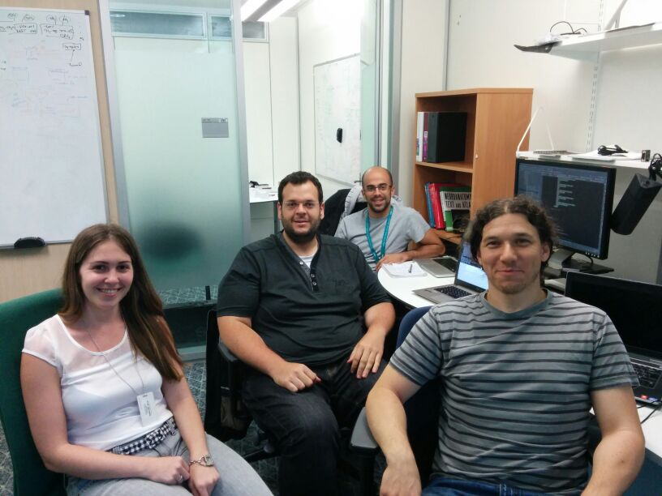

The Computational Genomics Department at the Centro de Investigación Príncipe Felipe (CIPF), Valencia, Spain, and…
@xdopazo
@bioinfocipf
… Computational Biology Lab, HPCS
University of Cambridge, UK...
…and EMBL-EBI
...the INB, National Institute of Bioinformatics (Functional Genomics Node)
and the BiER (CIBERER Network of Centers for Rare Diseases), and…

Slide 3
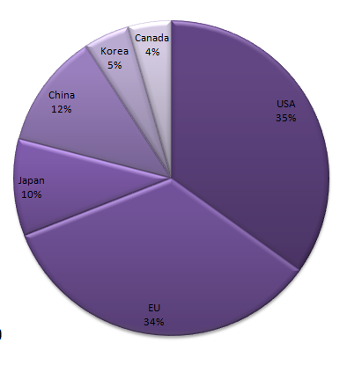
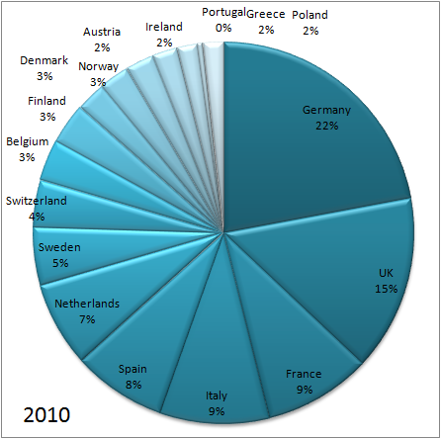
Some bibliographic data: Microarray publications
2010 Europe
2010 Worlwide
Source Pubmed. Query:
2009[Entrez Date] AND country[Affiliation]AND microarray[Title/Abstract]

Slide 4
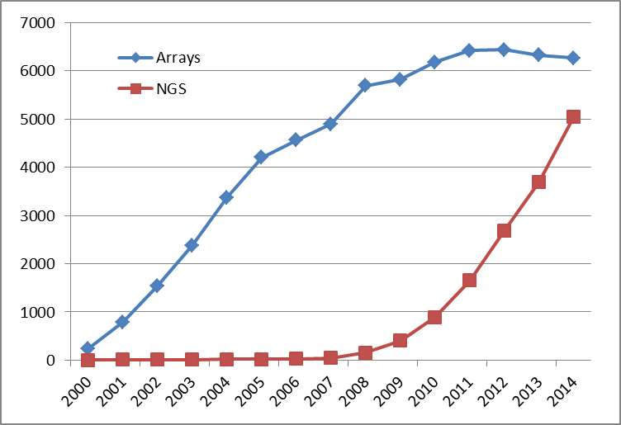
Evolution of the papers published in microarray and NGS technologies
Source Pubmed. Query: "high-throughput sequencing"[Title/Abstract] OR "next generation sequencing"[Title/Abstract] OR "rna seq"[Title/Abstract]) AND year[Publication Date]

Slide 5

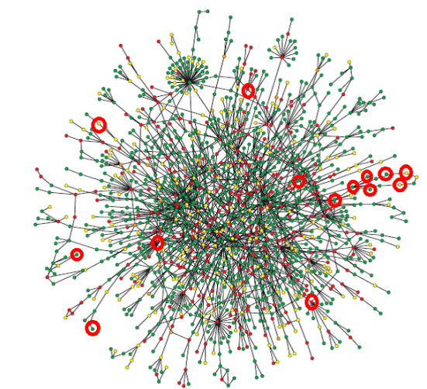
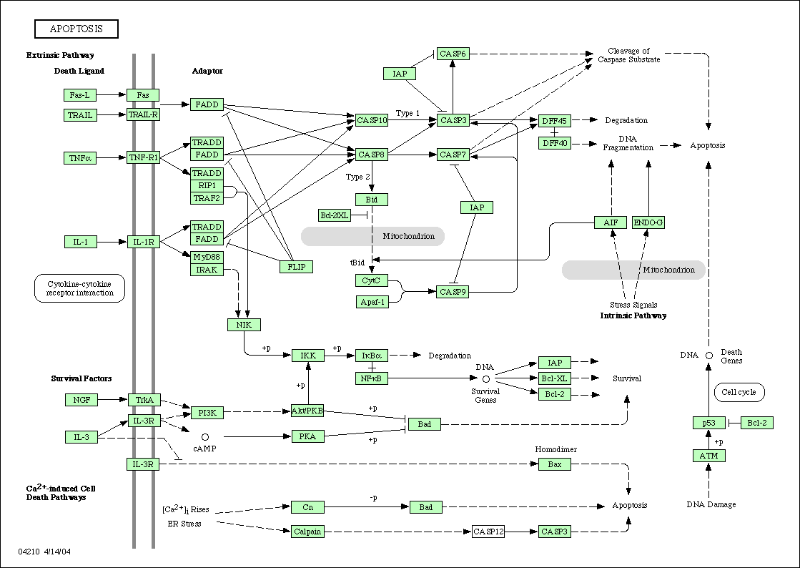
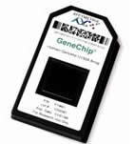
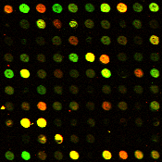
Genomic data, the double challenge: Data processing and interpretation
acggcgtaggtcattgcattcatactatcatcacaggcgggagttctatcagtcgtatctgatctataaaat
acggcgtaggtcattgcattcatactatcatcacaggcgggagttctatcagtcgtatctgatctataaaat
S
C
I
E
N
C
E
acggcgtaggtcattgcattcatactatcatcacaggcgggagttctatcagtcgtatctgatctataaaat
Read mapping and quantification
Fasta files and QC files
Intensity summary
Raw image generation
Transcriptomics
Technology driven
Hypothesis driven

Slide 6
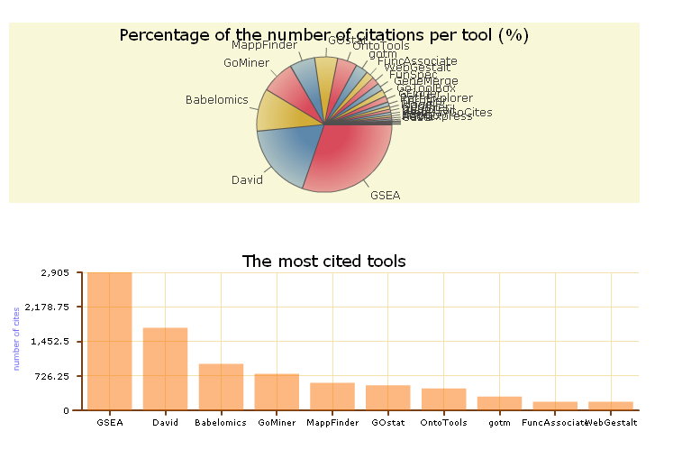
Tools for genomic data analysis and functional profiling

Slide 7
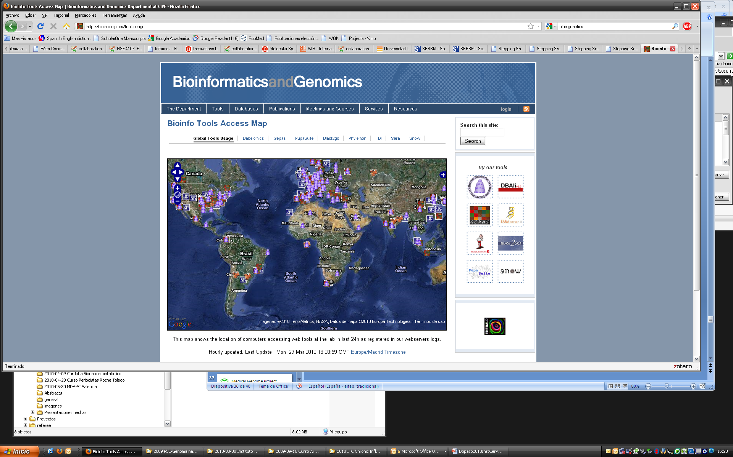
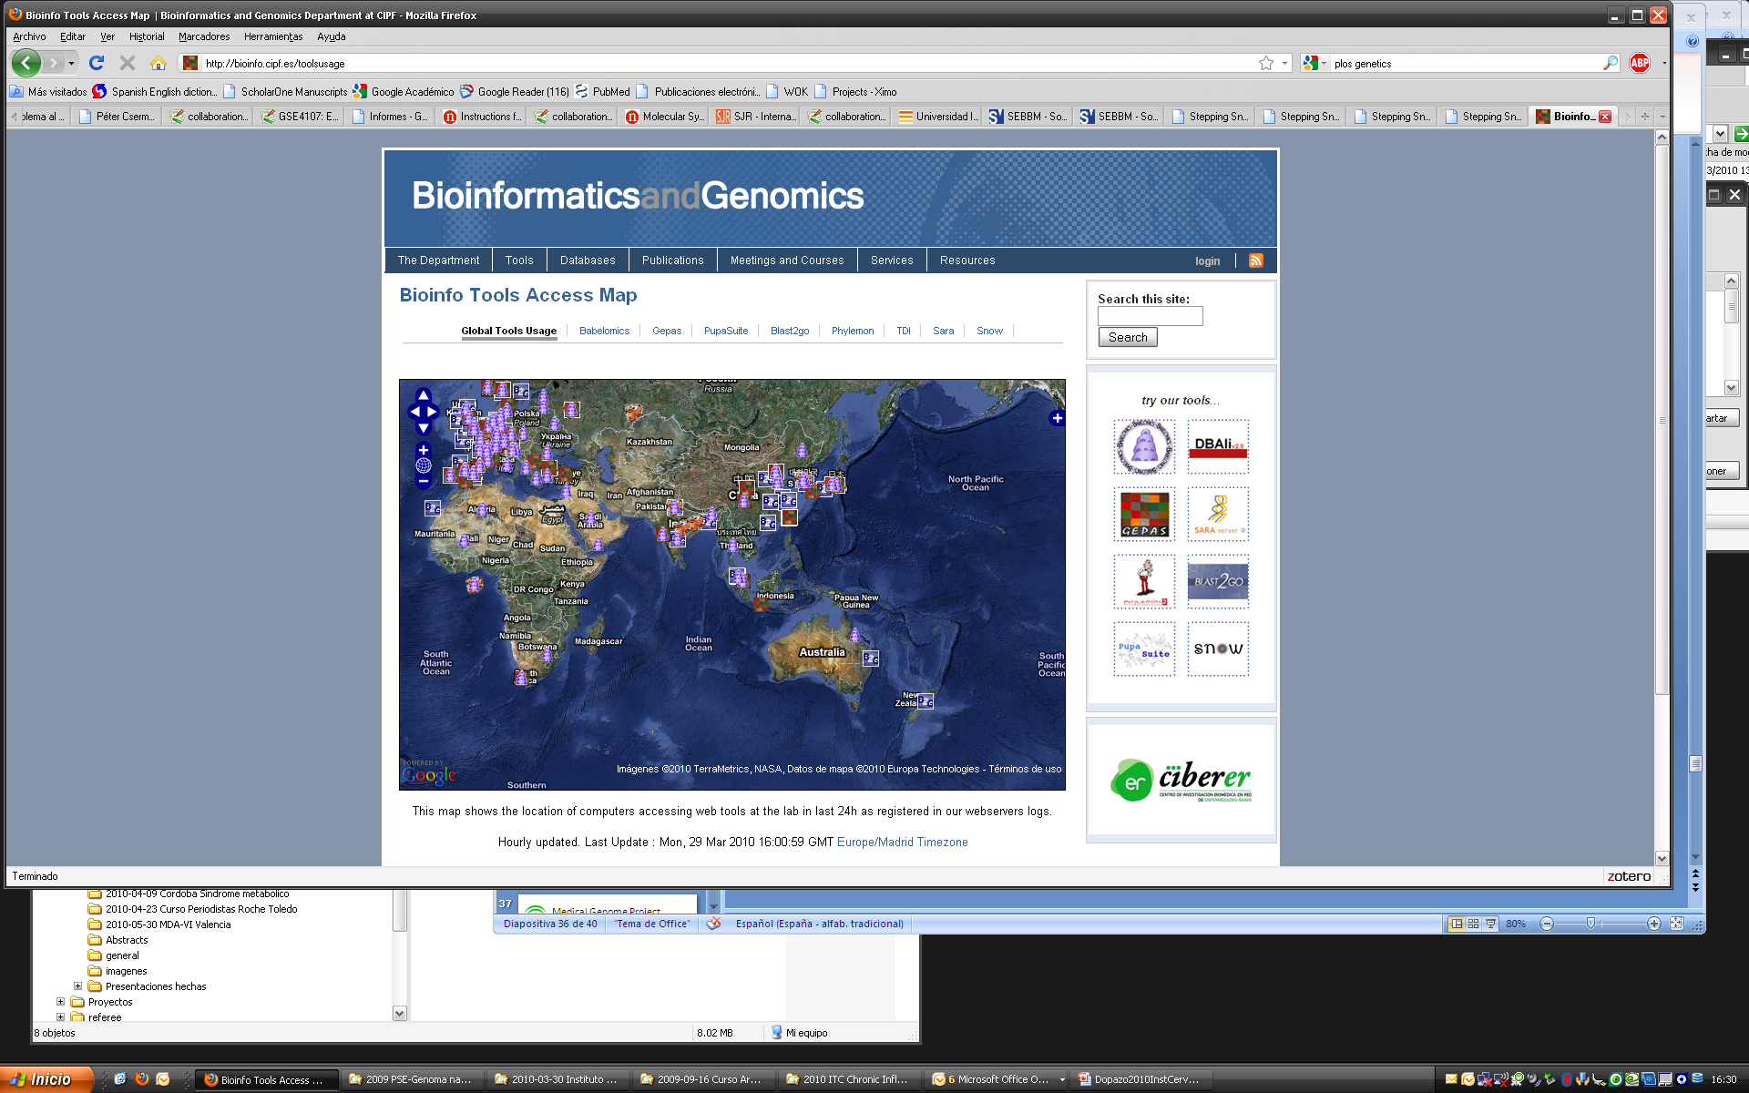
Some numbers
More than 150,000 experiments analysed during the last year.
More than 1000 experiments per day.
529 papers cite Babelomics (plus 798 FatiGO cites)
(source ISI Web of Knowledge, Februry2015)

Slide 8
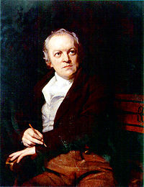
Background
The road of excess leads to the palace of wisdom
(William Blake, 28 November 1757 – 12 August 1827, poet, painter, and printmaker)
The introduction and popularisation of high-throughput techniques has drastically changed the way in which biological problems can be addressed and hypotheses can be tested.
But not necessarily the way in which we really address or test them…

Slide 9
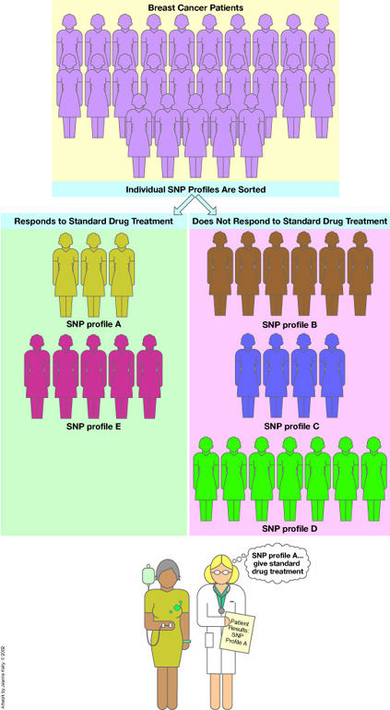
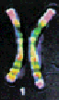
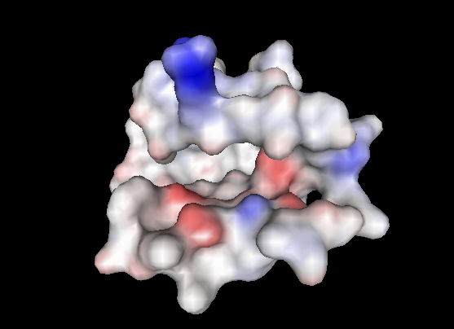
Where do we come from? The pre-genomics paradigm
Genes in the DNA...
…code for proteins...
…produces the final phenotype
From genotype to phenotype.
>protein kunase
acctgttgatggcgacagggactgtatgctgatctatgctgatgcatgcatgctgactactgatgtgggggctattgacttgatgtctatc....
…whose structure accounts for function...
…plus the environment...

Slide 10
Reduccionistic approach to link causes (genome) to effects (phenotype) through actions (function)
Causes
Effects
Genes in the DNA...
…code for proteins...
…produces the final phenotype
From genotype to phenotype.
>protein kunase
acctgttgatggcgacagggactgtatgctgatctatgctgatgcatgcatgctgactactgatgtgggggctattgacttgatgtctatc....
…whose structure accounts for function...
…plus the environment...
Function

Slide 11

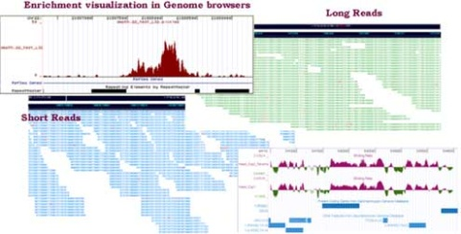
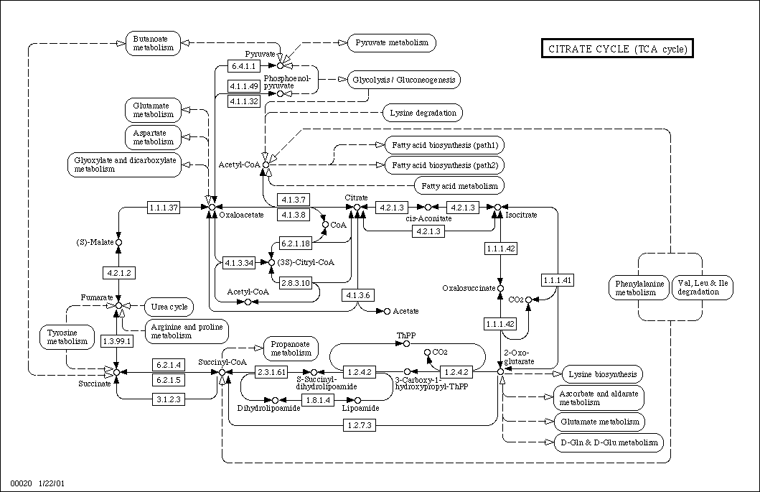

Genes in the DNA...
Next Generation Sequencing
10⁹bp per round
…whose final effect configures the phenotype...
…with its complex variability...
12 million SNPs in exonic regions
From genotype to phenotype.
(in the post-genomics scenario)
…when they are expressed in the proper moment and place...
…conforming complex interaction networks...
…in cooperation with other proteins…
…code for proteins...
Each protein has an average of 8 interactions
That undergo post-translational modifications, somatic recombination...
100K-500K proteins
…that account for function if...

Slide 12
Holistic approach. Causes and effects remain essentially the same. The concept of function has changed
Genes in the DNA...
Next Generation Sequencing
10⁹bp per round
…whose final effect configures the phenotype...
Causes
Effects
…with its complex variability...
From genotype to phenotype.
(in the functional post-genomics scenario)
Half a million of variants between pais of individuals
Function (modules of proteins)
…when they are expressed in the proper moment and place...
…conforming complex interaction networks...
…in cooperation with other proteins…
…code for proteins...
Each protein has an average of 8 interactions
That undergo post-translational modifications, somatic recombination...
100K-500K proteins
…that account for function if...
Notes:
All science is either physics or stamp collecting
Ernst Rutherford

Slide 13
High-throughput data for functional genomics
Genes in the DNA...
Next Generation Sequencing
10⁹bp per round
…whose final effect configures the phenotype...
Genome wide
…with its complex variability...
Genotyping
From genotype to phenotype.
(in the functional post-genomics scenario)
Half a million of variants between pais of individuals
Metabolomics
…when they are expressed in the proper moment and place...
…conforming complex interaction networks...
Transcriptomics
…in cooperation with other proteins…
Proteomics
…code for proteins...
Each protein has an average of 8 interactions
That undergo post-translational modifications, somatic recombination...
100K-500K proteins
…that account for function if...
Almost-omics

Slide 14
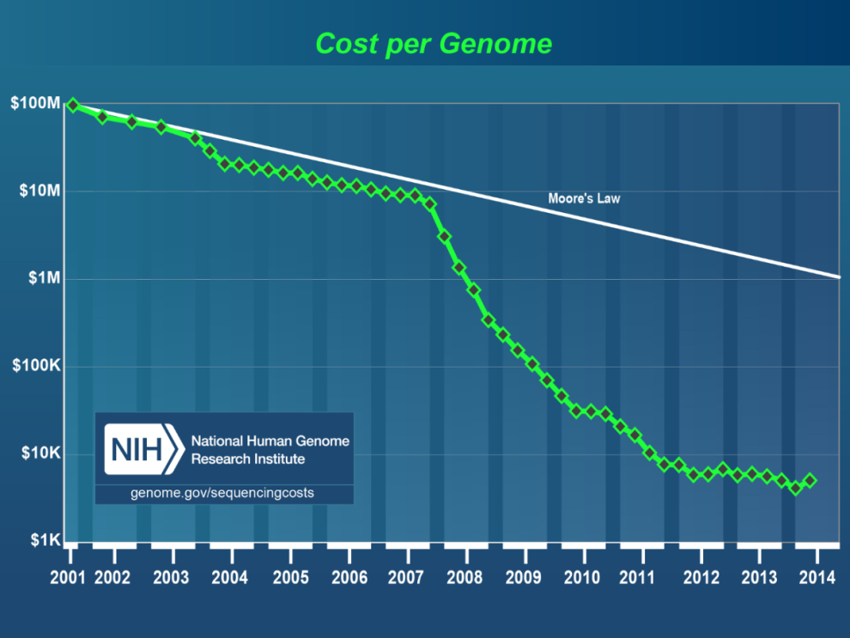
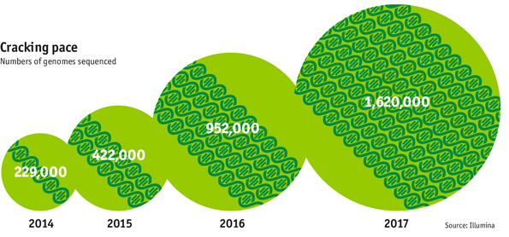
The genome sequencing pace
http://www.genome.gov/sequencingcosts/
NGS is matching the cost of many conventional clinical tests
http://www.economist.com/news/21631808-so-much-genetic-data-so-many-uses-genes-unzipped

Slide 15
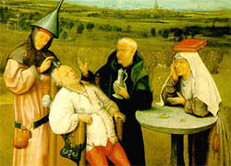
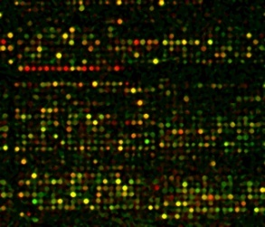
Gene expression profiling. Historic perspective
Differences at phenotype level are the visible cause of differences at molecular level which, in many cases, can be detected by measuring the levels of gene expression. The same holds for different experiments, treatments, strains, etc.
Classification of phenotypes / experiments. Can we distinguish among classes (either known or unknown), values of variables, etc. using molecular gene expression data? (sensitivity)
Selection of differentially expressed genes among the phenotypes / experiments. Did we select the relevant genes, all the relevant genes and nothing but the relevant genes? (specificity)
Biological roles the genes are carrying out in the cell. What general biological roles are really represented in the set of relevant genes? (interpretation)

Slide 16
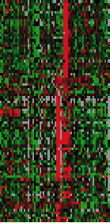
Studies must be hypothesis driven. What is the aim? Class discovery? sample classification? gene selection? ...
Can we find groups of experiments with similar gene expression profiles?
Unsupervised
Different classes...
Supervised
Molecular classification of samples
What genes are responsible for?
Co-expressing genes...
What do they have in common?

Slide 17
Unsupervised problem: class discovery
Our interest is in discovering clusters of items (genes or experiments) which we do not know beforehand
Can we find groups of experiments with similar gene expression profiles?
What genes co-express?
How many different expression patterns do we have?
What do they have in common?
Etc.
Co-expressing genes...

Slide 18
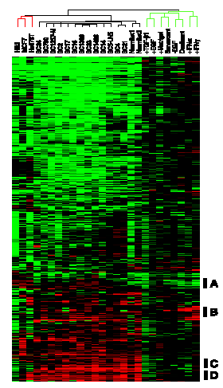
Clustering of experiments: The rationale
If enough genes have their expression levels altered in the different experiments, we might be able of finding these classes by comparing gene expression profiles.
Distinctive gene expression patterns in human mammary epithelial cells and breast cancers
Overview of the combined in vitro and breast tissue specimen cluster diagram. A scaled-down representation of the 1,247-gene cluster diagram The black bars show the positions of the clusters discussed in the text: (A) proliferation-associated, (B) IFNregulated, (C) B lymphocytes, and (D) stromal cells.
Perou et al., PNAS (1999)

Slide 19
Supervised problems. Differential gene expression
Can we find groups of experiments with similar gene expression profiles?
Different classes...
Molecular classification of samples
What genes are responsible for?
Co-expressing genes...
What do they have in common?

Slide 20
Differential gene expression The simplest way: univariant gene-by-gene. Other multivariant approaches can be used
Two classes
T-test
Limma
Fold-change
Multiclass
Anova
Limma
Continuous variable (e.g. level of a metabolite)
Pearson
Spearmam
Regression
Survival
Cox model
Time Course

Slide 21
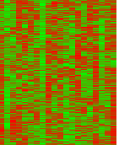
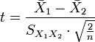
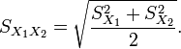
Differential gene expression
cases controls
The t-statistic was introduced in 1908 by William Sealy Gosset
cases controls
X₁
X₂
Significantly different
S_{X1}
S_{X2}
X₁
X₂
Non significantly different
S_{X1}
S_{X2}
being

Slide 22
Supervised problems. sample classification
Can we find groups of experiments with similar gene expression profiles?
Different classes...
Molecular classification of samples
What genes are responsible for?
Co-expressing genes...
What do they have in common?

Slide 23
Predictors and molecular signatures
What is a predictor?
Intuitive notion:
A B X
Diff (B, X) = 2 Diff (A, X) = 13
Is X, A or B?
Most probably X belongs to class B
Algorithms: DLDA, KNN, SVM, random forests, PAM, etc.

Slide 24
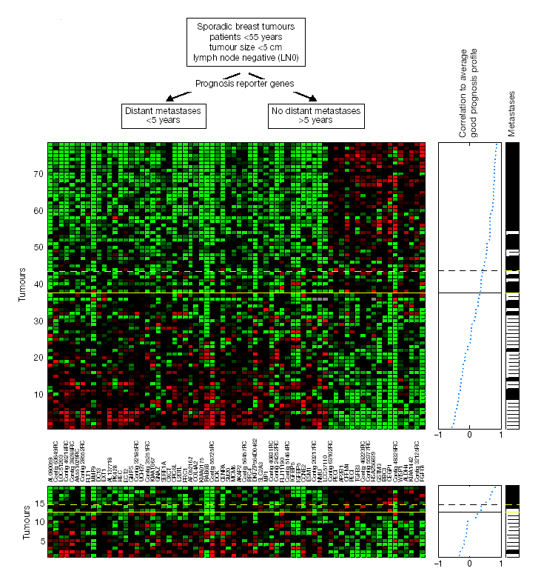
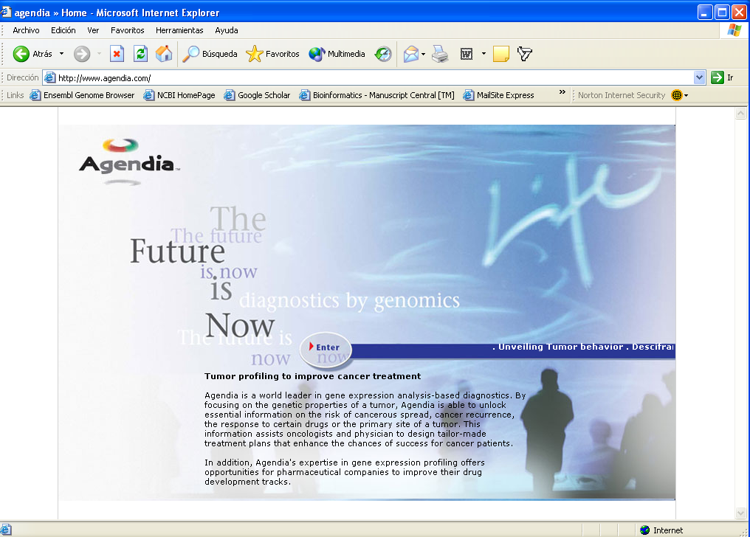
Predictor of clinical outcome in breast cancer
Genes are arranged to their correlation eith the pronostic groups
Pronostic classifier with optimal accuracy
van’t Veer et al., Nature, 2002

Slide 25
Genotyping: finding mutations associated to diseases
The simplest case: monogenic disease
A
B
C
D
E
Controls
Gene A 1 0 0 0 0 0 0 0 0 0 0 0 0 0 0 0 1 0 0 0 0 0 0 0
Gene B 0 0 0 1 0 0 0 0 0 0 0 0 0 0 0 0 0 0 0 0 0 0 0 0
Gene C 0 0 0 0 0 0 0 0 0 0 0 0 1 1 1 1 1 1 1 1 1 1 1 1
Gene D 0 0 0 0 0 0 0 0 0 0 1 0 0 0 0 0 0 0 0 0 0 0 0 0
Gene E 0 0 0 0 0 1 0 0 0 0 0 0 0 0 0 0 0 0 0 1 0 0 0 0
Cases

Slide 26
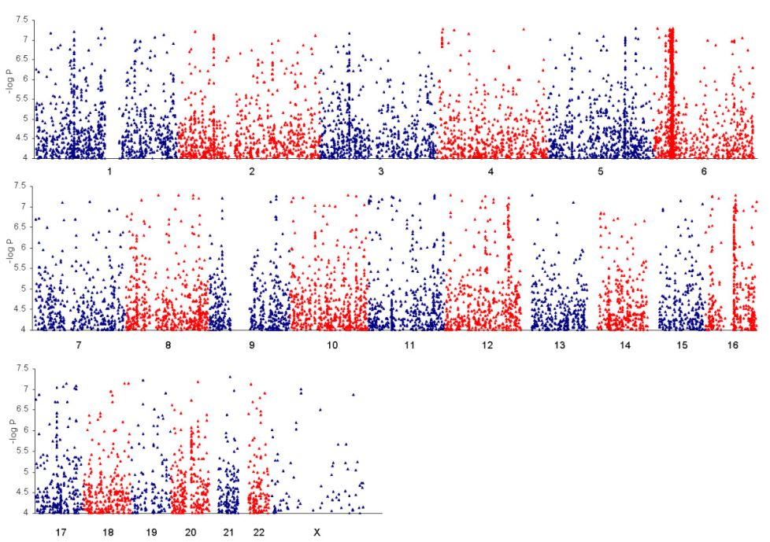
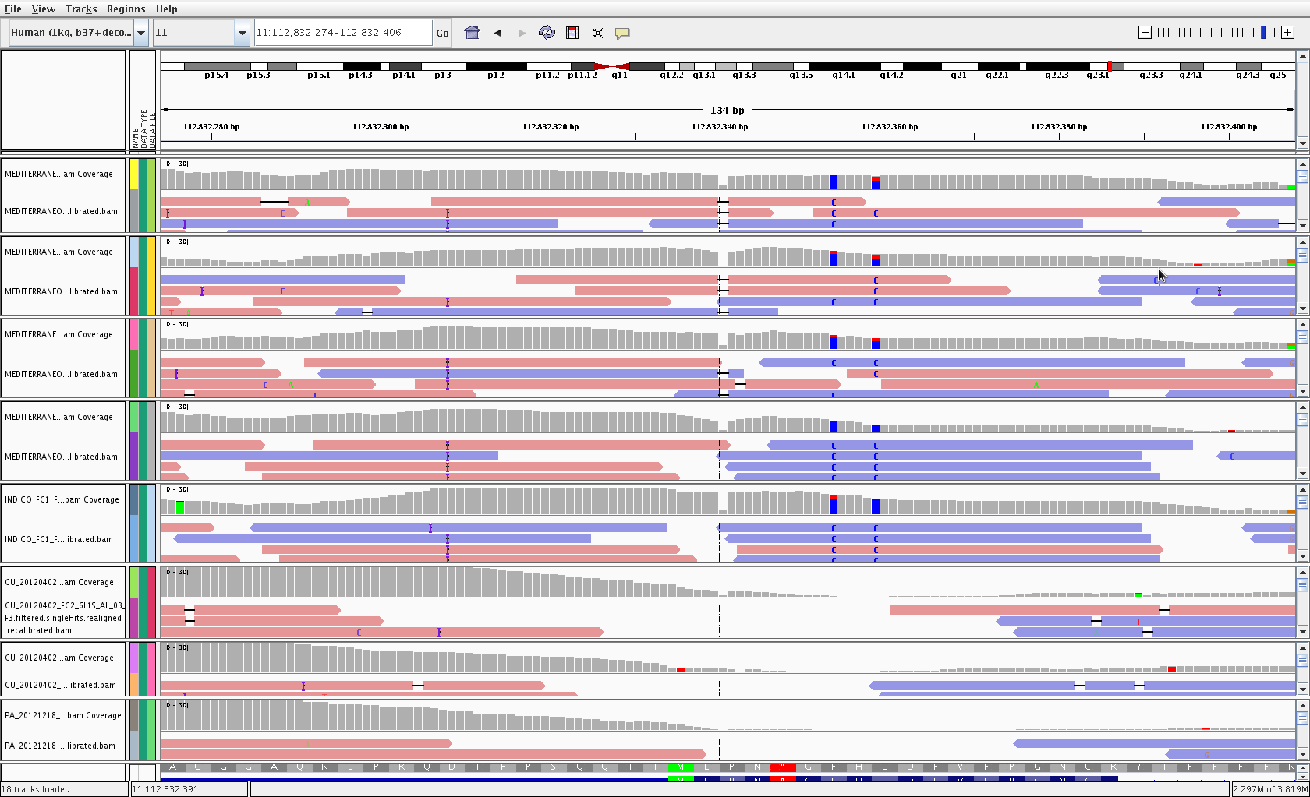
Genotyping and nowadays NGS

Slide 27
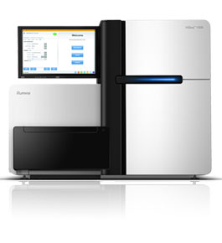

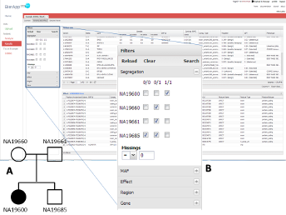
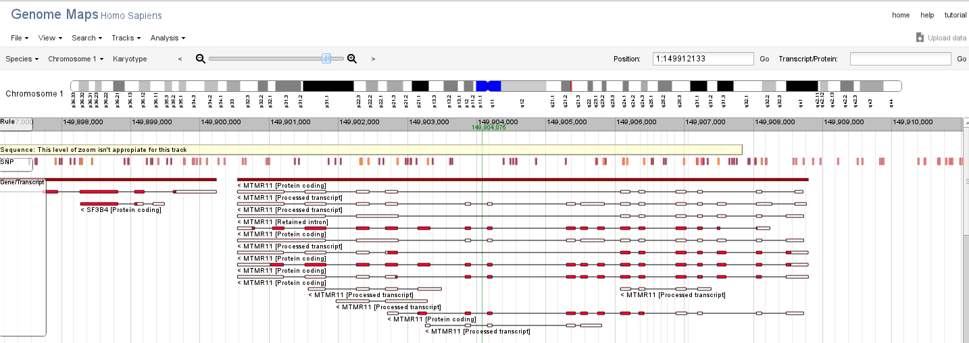
Primary data analysis tools
Fastq file, up to hundreds of GB per run
QC and preprocessing
QC stats, filtering and preprocessing options
HPG Aligner, short read aligner
Double mapping strategy:
Burrows-Wheeler Transform (GPU Nvidia CUDA) + Smith-Waterman (CPU OpenMP+SSE/AVX)
SAM/BAM file
QC and preprocessing
QC stats, filtering and preprocessing options
Variant calling analysis
GATK and SAM mPileup HPC
Implementation.
Statistics genomic tests
VCF file
QC and preprocessing
QC stats, filtering and preprocessing options
Genome Maps. Variant VCF viewer
BiERApp candidate gene prioritization
HTML5+SVG Web based viewer
Consequence type, pathogenicity, Population frequencies, etc

Slide 28
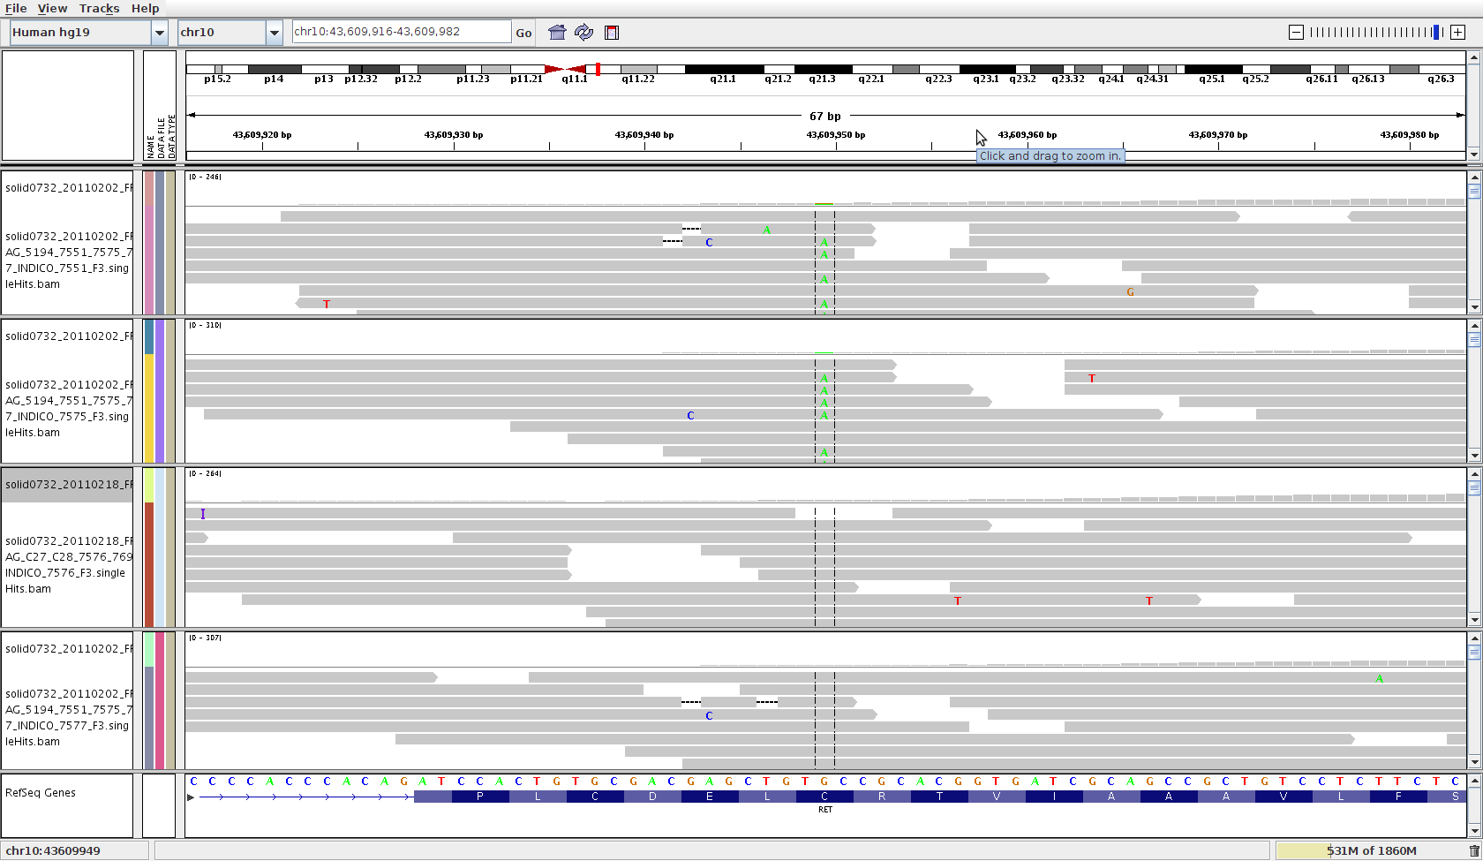
The principle: comparison of patients to reference controls or segregation within families
Cases
Controls
A
Segregation within a pedigree
A
B
D
B
D
C
C

Slide 29
Variant/gene prioritization by successive filtering
Variant level
Potential impact of the variant
Population frequencies
Experimental design level
Family(es)
Trios
Case / control
Functional (system) level
Gene set
Network analysis
Pathway analysis
Control of sequencing errors (missing values)
Testing strategies

Slide 30
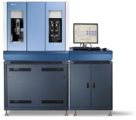
Pipeline of data analysis
Initial QC
Sequence cleansing
Base quality
Remove adapters
Remove duplicates
FASTQ file
Mapping + QC
Mapping (HPG)
Remove multiple mapping reads
Remove low quality mapping reads
Realigning
Base quality recalibrating
BAM file
Variant calling + QC
Calling and labeling of missing values
Calling SNVs and indels (GATK) using 6 statistics based on QC, strand bias, consistence (poor QC callings are converted to missing values as well)
Create multiple VCF with missing, SNVs and indels
VCF file
Variant and gene prioritization + QC
Counts of sites with variants
Variant annotation (function, putative effect, conservation, etc.)
Inheritance analysis (including compound heterozygotes in recessive inheritance)
Filtering by frequency with external controls (Spanish controls, dbSNP, 1000g, 5500g) and annotation
Multi-family intersection of genes and variants
Network-based prioritization
Report
Primary analysis
Gene prioritization

Slide 31
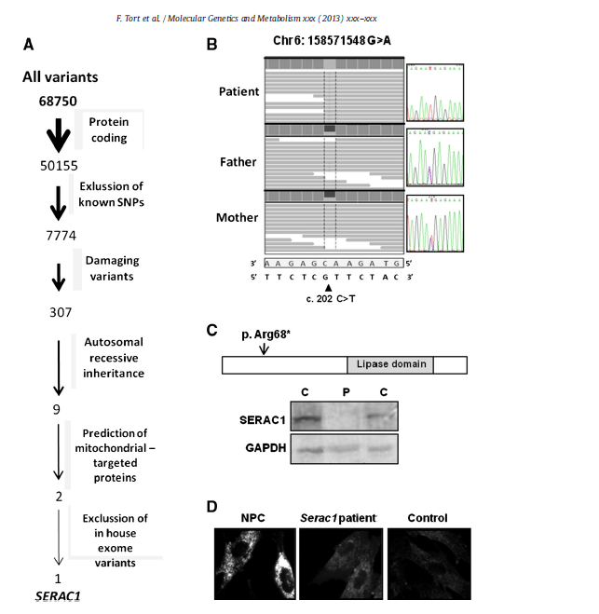
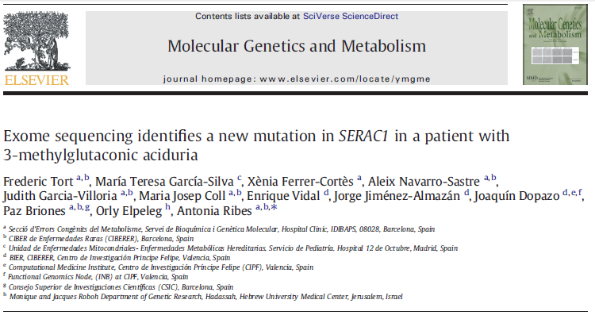
Successive Filtering approach An example with 3-Methylglutaconic aciduria syndrome
3-Methylglutaconic aciduria (3-MGA-uria) is a heterogeneous group of syndromes characterized by an increased excretion of 3-methylglutaconic and 3-methylglutaric acids.
WES with a consecutive filter approach is enough to detect the new mutation in this case.

Slide 32
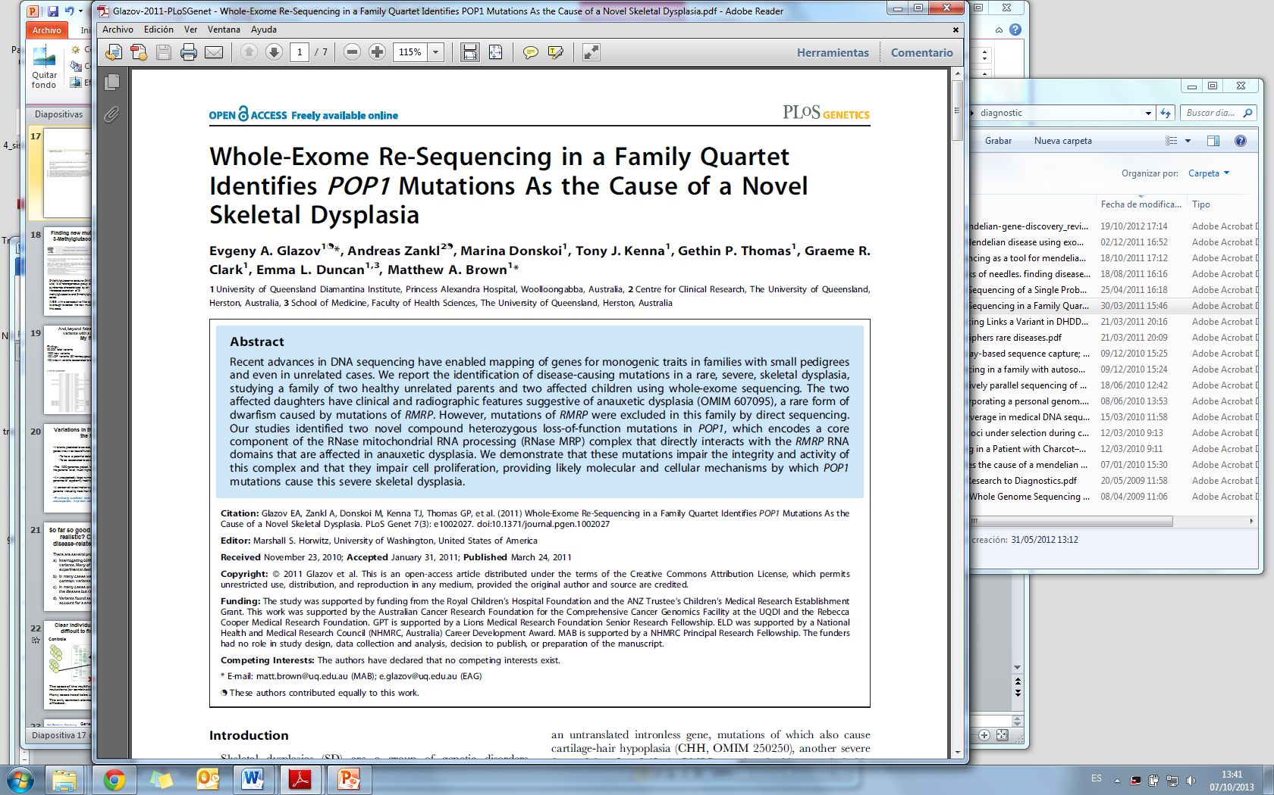
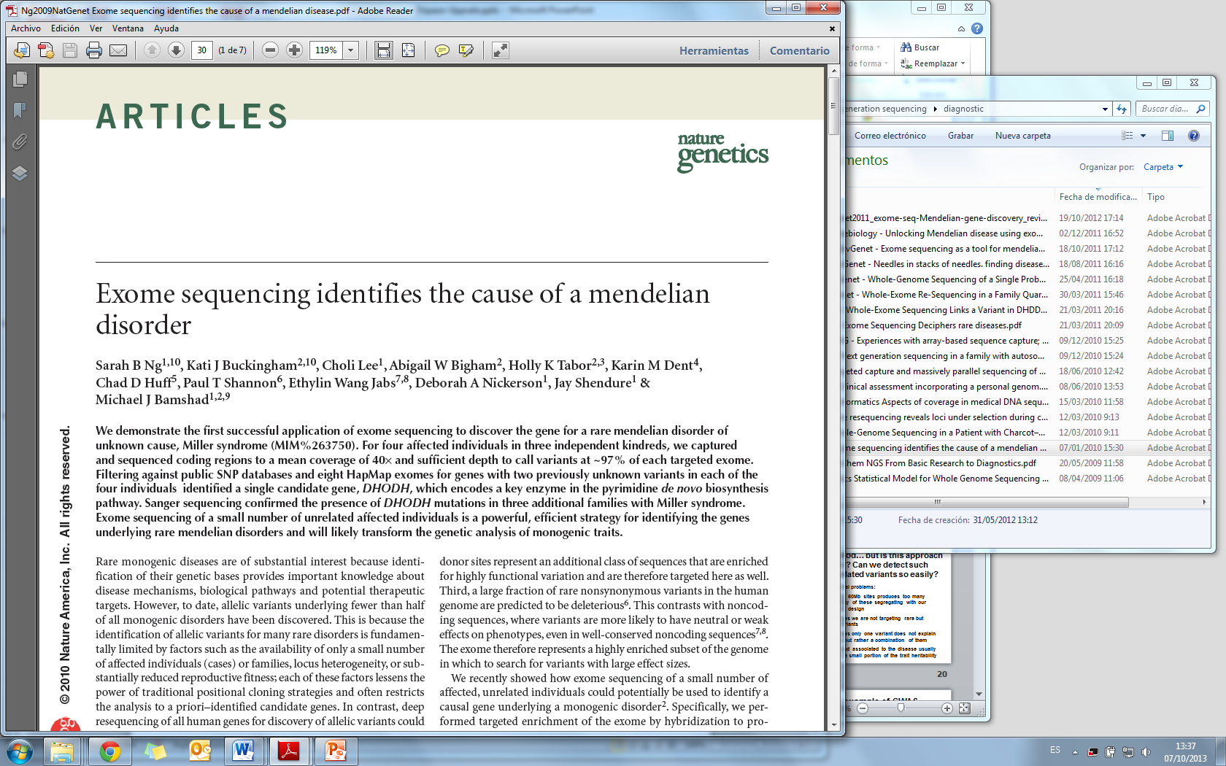
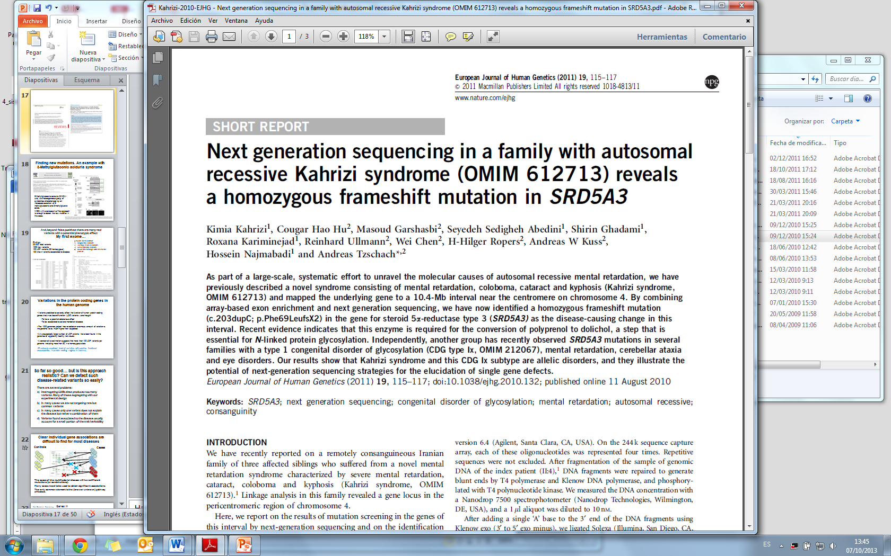
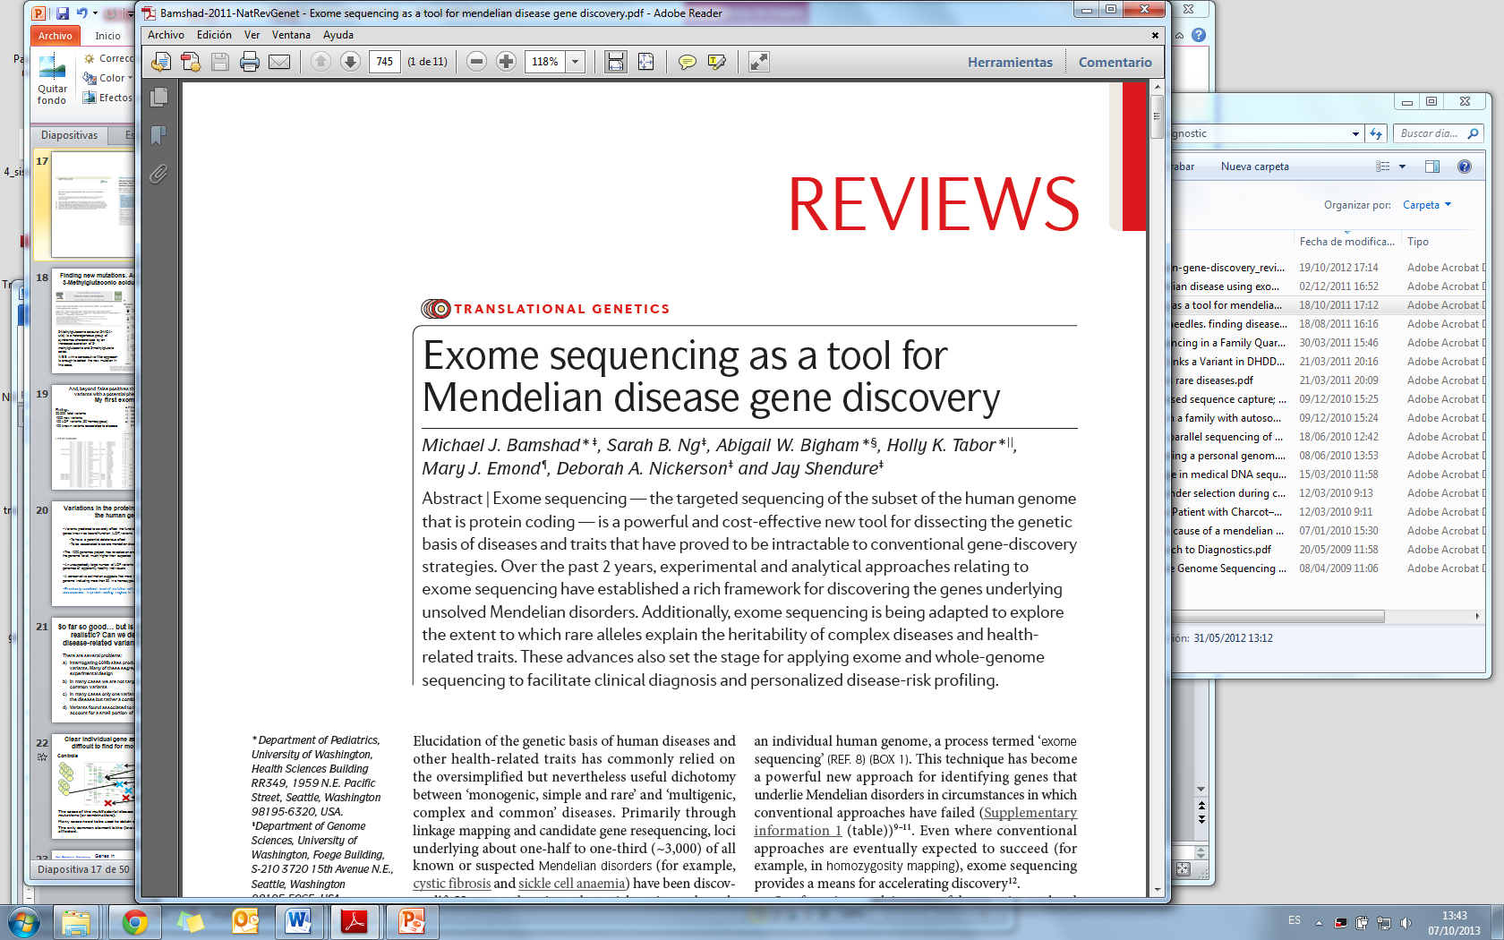
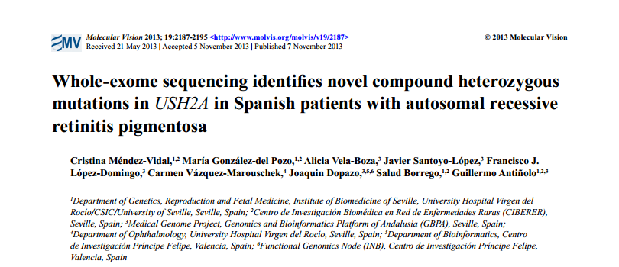
Exome sequencing has been systematically used to identify Mendelian disease genes

Slide 33
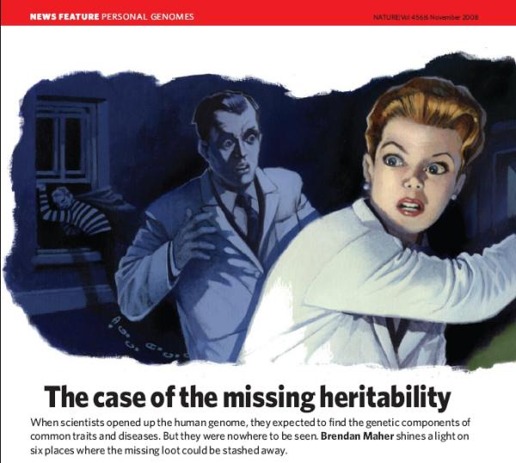
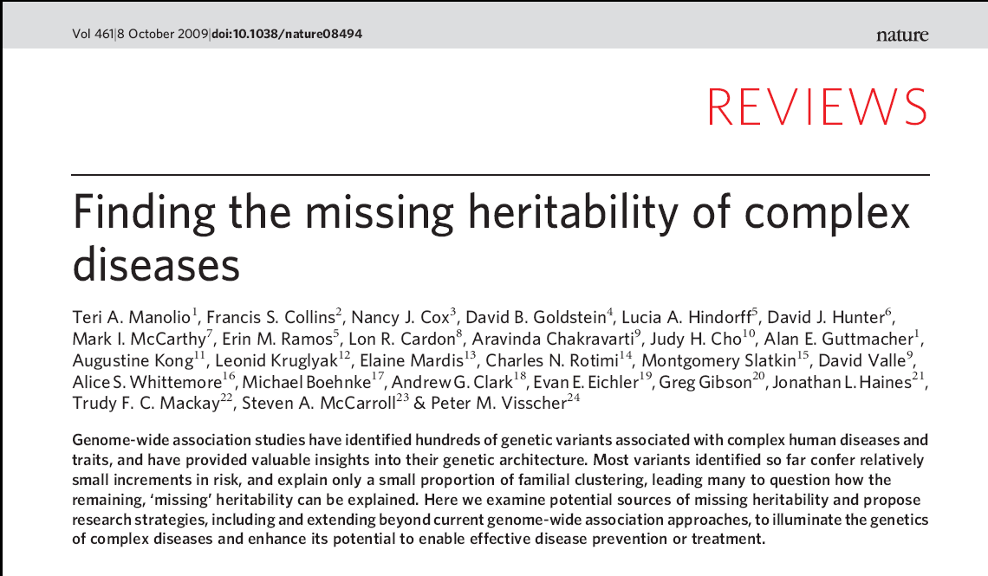
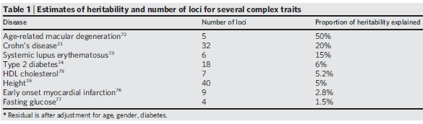
Where did the heritability go?
The missing heritability problem: individual genes cannot explain the heritability of traits
How to explain all this?
Rare Variants, rare CNVs, epigenetics or.. epistatic effects?

Slide 34
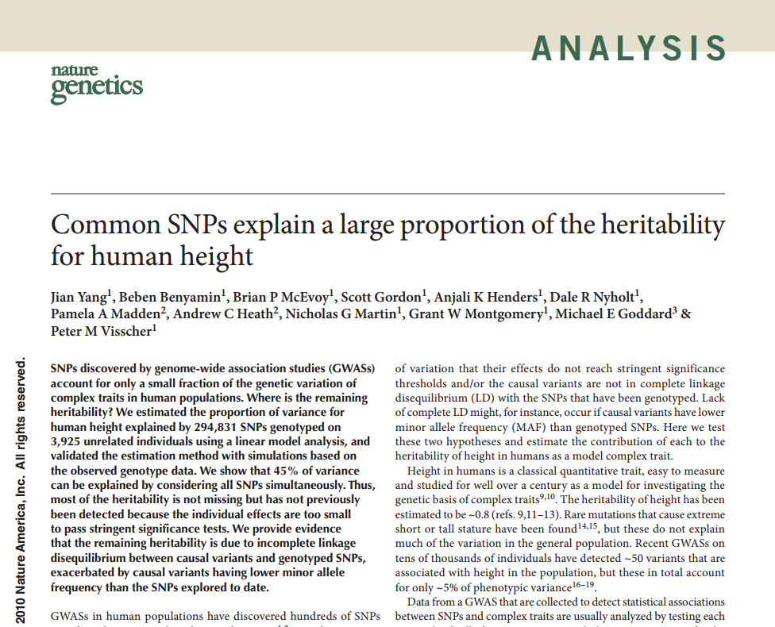
Is the heritability missing or are we looking at the wrong place?
How to explain missing heritability?
Rare Variants, rare CNVs, epigenetics or.. epistatic effects?
At the end, most of the heritability was there…

Slide 35
An approach inspired on systems biology can help in detecting causal genes
Controls
Cases
Affected cases in complex diseases will be a heterogeneous population with different mutations (or combinations).
Many cases and controls are needed to obtain significant associations.
The only common element is the (know or unknown) pathway affected.
Disease understood as the failure of a functional module

Slide 36
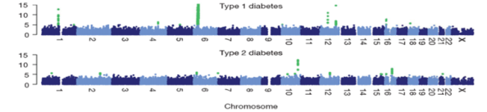




From gene-based to function-based perspective
SNPs
WES/WGS
Gene integrity
AND/OR
Gene activity
Gene Ontology
Gene expression
Gene Ontology are labels to genes that describe, by means of a controlled vocabulary (ontology), the functional role(s) played by the genes in the cell.
A set of genes sharing a GO annotation can be considered a functional module.

Slide 37
An example of GWAS
GWAS in Breast Cancer.
The CGEMS initiative. (Hunter et al. Nat Genet 2007)
1145 cases 1142 controls. Affy 500K
Conventional association test reports only 4 SNPs significantly mapping only on one gene: FGFR2
Conclusions: conventional SNP-based or gene-based tests are not providing much resolution.

Slide 38

The same GWAS data re-analyzed using a function-based test
Breast Cancer
CGEMS initiative. (Hunter et al. Nat
Genet 2007)
1145 cases 1142 controls. Affy 500K
Only 4 SNPs were significantly associated, mapping only in one gene: FGFR2
PBA reveals 19 GO categories including regulation of signal transduction (FDR-adjusted p-value=4.45x10⁻⁰³) in which FGFR2 is included.
Bonifaci et al., BMC Medical Genomics 2008; Medina et al., 2009 NAR

Slide 39

GO processes significantly associated to breast cancer
Metastasis
Chromosomal instability
Rho pathway

Slide 40

From gene-based to function-based perspective
SNPs,
Gene expression
Gene₁
Gene₂
Gene₃
Gene₄
:
:
:
Gene₂₂₀₀₀
Gene Ontology
 | SNPs, gene exp. | GO
Detection power | Low (only very prevalent genes) | high
Annotations available | many | many
Use | Biomarker | Illustrative, give hints

Slide 41



Can the interactome help to find disease mutations?
Disease genes are close in the interactome
Goh 2007 PNAS
Cancer genes are central.
Hernandez, 2007 BMC Genomics
Deleterious mutations in 1000g (up) and somatic CLL deleterious mutations (down)
Garcia-Alonso 2014 Mol Syst Biol

Slide 42


From gene-based to function-based perspective
Using protein interaction networks as an scaffold to interpret the genomic data in a functionally-derived context
SNPs
WES/WGS
Gene integrity
AND/OR
Gene activity
What part of the interactome is active and/or is damaged
Gene expression

Slide 43
Example with Inherited Retinal Dystrophies
Prevalence 1 in 3000
Clinically and genetically very heterogeneous
190 GENES account for aprox. 50% of IRDs.
Families with
digenism
Families with
known
mutations
Families with
unknown
mutations
Families with
one mutant
allele
Diagnosed
families
Novel variants and genes remain to be discovered
Notes:
Las distrofias de retina con un grupo de enfermedades genética y fenotípicamente heterogéneas caracterizadas por la degeneración de la retina, que conduce a una ceguera parcial o total.
La identificación de nuevos genes responsables de enfermedades de retina es la base por tanto de los avances en el conocimiento de la fisiología y la patología de la retina; de esta manera, será posible establecer nuevas líneas celulares y modelos animales para estudiar las funciones de los genes relevantes que permitan en última instancia mejorar las alternativas terapéuticas para las distrofias de retina.

Slide 44
Network analysis. Is genetic overlapping among IRDs related to protein interaction?
BBS
ARL6,, BBS2, BBS4,
BBS5, BBS7, BBS9,
BBS10, BBS12,, INPP5E,
LZTFL1, MKKS, MKS1,
SDCCAG8, TRIM32, TTC8
LCA
CORD/COD
LCA5,
RD3
CACNA1F,
CACNA2D4
CEP290
CVD
GNAT2
CORD/COD
AIPL1,
GUCY2D,
RPGRIP1
CRB1, IMPDH1,
LRAT, MERTK,
RDH12, RPE65,
SPATA7, TULP1
BBS1
CABP4,
GRK1,
GRM6,
NYX,
TRPM1
NB
PDE6B,
RHO,
SAG
ADAM9,
GUCA1A,
HRG4/UNC119,
KCNV2, PDE6H,
PITPNM3, RAX2,
RDH5, RIM1
CRX
C2ORF71, C8ORF37,
CA4,CERKL, CNGA1, CNGB1,
DHDDS,EYS, FAM161A, IDH3B,KLHL7
IMPG2, MAK, NRL, PAP1, PDE6A,
PDE6G, PRCD, PRF3, PRPF8, PRPF31
RBP3, RGR, ROM1, RP1, RP2,
SNRNP200, TOPORS, TTC8
ZNF513
LCA-Leber Congenital Amaurosis
CORD/COD- Cone and cone-rod dystro.
CVD- Colour Vision Defects
MD- Macular Degeneration
ERVR/EVR- Erosive and Exudative
Vitreoretinopathies
USH- Usher Syndrome
RP- Retinitis Pigmentosa
NB- Night Blindness
BBS- Bardet-Biedl Syndrome
RLBP1,
SEMA4A
RP
ABCA4,
PROM1,
PRPH2,
RPGR
CVD
CNGA3,
PDE6C
BCP,
GCP,
RCP
FSCN2,
GUCA1B
CLRN1,
USH2A
C1QTNF5,
EFEMP1,
ELOVL4,
HMNC1,
RS1,
TIMP3
BEST1
ABHD12, CDH23, CIB2, DFNB31, GPR98, HARS, MYO7A, PCDH15, USH1C, USH1G
NR2E3
FZD4, KCNJ13,
LRP5, NDP,
TSPAN12, VCAN
MD
USH
ERVR/EVR

Slide 45

Connectivity among IRDs explain genetic overlap
LCA-Leber Congenital Amaurosis
CORD/COD- Cone and cone-rod dystro.
CVD- Colour Vision Defects
MD- Macular Degeneration
ERVR/EVR- Erosive and Exudative
Vitreoretinopathies
USH- Usher Syndrome
RP- Retinitis Pigmentosa
NB- Night Blindness
BBS- Bardet-Biedl Syndrome
Significant Clustering coefficient,
p-value=0.0103
LCA
BBS
CORD/COD
NB
RP
CVD
MD
ERVR/EVR
USH
SNOW Tool. Minguez et al., NAR 2009 Implemented in Babelomics (http://www.babelomics.org)

Slide 46




Network analysis helps to find disease genes in complex diseases
CHRNA7 (rs2175886 p = 0.000607)
IQGAP2 (rs950643 p = 0.0003585)
DLC1 (rs1454947 p = 0.007526)
RASGEF1A* (rs1254964 p = 3.856x10⁻⁰⁵)
*no interactions known (yet)
SNPs validated in independent cohorts

Slide 47


Software that detects the most significant sub-network within a list of genes
Network analysis and the interactive, web-based network viewer CellMaps
http://cellmaps.babelomics.org/

Slide 48
From gene-based to function-based perspective
 | SNPs, gene expression, etc. | GO | Protein interaction networks
Detection power | Low (only very prevalent genes) | High | High
Information coverage | Almost all | Almost all | Less (~9000 genes in human)
Use | Biomarker | Illustrative, give hints | Biomarker*
*Need of extra information (e.g. GO) to provide functional insights in the findings

Slide 49


Modeling pathways
Activation
A
B
Prob. = P(A activated)P(B activated)
Inhibition
A
B
Prob. = [1-P(A activated)]P(B activated)
Sub-pathway
B
D
A
F
G
C
E
P(A→G activated) = P(A)P(B)P(D)P(F)P(G) + P(A)P(C)P(E)P(F)P(G) - P(A)P(F)P(G)P(B)P(C)P(D)P(E)

Slide 50
From gene-based to mechanism-based perspective
Transforming gene expression values into another value that accounts for a function. Easiest example of modeling function: signaling pathways. Function: transmission of a signal from a receptor to an effector
Receptor
Effector
Activations and repressions occur

Slide 51


Apoptosis inhibition is not obvious from gene expression
Two of the three possible sub-pathways leading to apoptosis are inhibited in colorectal cancer. Upper panel shows the inhibited sub-pathways in blue. Lower panel shows the actual gene up-regulations (red) and down-regulations (blue) that justify this change in the activity of the sub-pathways

Slide 52
From gene-based to function-based perspective
 | SNPs, gene expression, etc. | GO | Protein interaction networks | Models of cellular functions
Detection power | Low (only very prevalent genes) | High | High | Very high
Information coverage | Almost all | Almost all | Low (~9000 genes in human) | Low (~6700 genes in human)*
Use | Biomarker | Illustrative, give hints | Biomarker | Biomarker that explain disease mechanism
*Only ~800 genes in human signaling pathways

Slide 53









Software development
Functional analysis
Mapping
HPC on CPU, SSE4, GPUs on NGS data processing
Speedups up to 40X
Visualization
Ultrafast genome viewer with google technology
Babelomics is the third most cited tool for functional analysis. Includes more than 30 tools for advanced, systems-biology based data analysis
See interactive map of for the last 24h use http://bioinfo.cipf.es/toolsusage
Variant prioritization
Diagnostic
Genome maps is now part of the ICGC data portal
NGS panels
Variant annotation
Signaling network
Regulatory network
Interaction network
CellBase
Knowledge database
More than 150.000 experiments were analyzed in our tools during the last year

Slide 54


Babelomics in the Maniatis
The Babelomics suite of programs becomes a classic. Now is cited as a method in the last edition of Molecular Cloning, the popular Maniatis. The protocol 4 of chapter 8, Expression Profiling by Microarray and RNA-seq, contains a description on how to use Babelomics to analyze expression data.
High impact developments

Slide 55



SOCIAL: MDA group in Linked-in Babelomics group in Facebook and twitter
@babelomics

Slide 56
The Computational Genomics Department at the Centro de Investigación Príncipe Felipe (CIPF), Valencia, Spain, and…
@xdopazo
@bioinfocipf
… Ignacio Medina
Head of Computational Biology Lab, HPCS
University of Cambridge, UK
EMBL-EBI Scientific Collaborator
...the INB, National Institute of Bioinformatics (Functional Genomics Node)
and the BiER (CIBERER Network of Centers for Rare Diseases), and…

